Slide 1

Exploring the Dynamic Relationships between COVID-19 and Influenza
By Jordan Ramey John Hofmann

Slide 2
Introduction/Motivation
COVID-19 had strained global healthcare systems, potentially altering the dynamics of Influenza.
There's a need to understand the interplay between COVID-19 and pre-existing diseases to devise effective public health strategies.
Our study will leverage empirical and forecasting models to analyze the complex interactions.
Our models aim to aid policy-makers in making informed decisions and implementing targeted interventions.
Using accessible data sources, we focus on assessing the efficacy of various health policies in mitigating epidemics.

Slide 3
Problem Definition
Primary goal: Analyze COVID-19's impact on influenza trends across the US, Sweden, and China.
Highlight changes in influenza trends prior to the COVID-19 pandemic, noting the decline in cases and subsequent return to normal trend.
Evaluate the effect of public health policies and interventions on the spread of influenza in the selected subset countries.
Train an LSTM model on relevant data to forecast potential influenza cases in the absence of the COVID-19 pandemic.
Compare the estimated models with the real data to identify most impactful factors and policies on reported cases.

Slide 4
Proposed Approaches
Explore the alterations in Influenza trends before and during the COVID-19 pandemic
Evaluate the influence of public health policies and interventions, such as mask mandates, social distancing measures, and limitations on gatherings, on the circulation of Influenza viruses in the selected subset countries
Develop an LSTM model to estimate the number of Influenza cases that would have occurred without the COVID-19 pandemic
Using the differences in our estimated models and real-world data, analyze the policies and factors to find trends revealing what had the most impact reported cases

Slide 5
Data Sources:
COVID-19 (2020 - March 2023): World Health Organization
Influenza (2015 – February 2023): World Health Organization
Policies (2020-2022): Our World in Data
Population (1960-2021): The World Bank
Covid:
https://app.powerbi.com/view?r=eyJrIjoiYWRiZWVkNWUtNmM0Ni00MDAwLTljYWMtN2EwNTM3YjQzYmRmIiwidCI6ImY2MTBjMGI3LWJkMjQtNGIzOS04MTBiLTNkYzI4MGFmYjU5MCIsImMiOjh9
Influenza:
https://app.powerbi.com/view?r=eyJrIjoiNjViM2Y4NjktMjJmMC00Y2NjLWFmOWQtODQ0NjZkNWM1YzNmIiwidCI6ImY2MTBjMGI3LWJkMjQtNGIzOS04MTBiLTNkYzI4MGFmYjU5MCIsImMiOjh9
Policies:
https://ourworldindata.org/policy-responses-covid
The World Bank:
https://data.worldbank.org/indicator/SP.POP.TOTL
Notes:
JH

Slide 6
Data Characteristics:
COVID-19:
42.9 MB Microsoft Excel file
598,227 rows, 29 columns
Columns: WHO_REGION, COUNTRY_NAME, COUNTRY_CODE, ISO_YEAR, ISO_WEEK, ISO_START_DATE, SEX, AGEGROUP, AGEGROUP_NUM, DAILY_CASES, DAILY_CASES_DEATHS, DETAILED_CASES, DETAILED_CASES_DEATHS, DETAILED_CASES_CONFIRMED, DETAILED_CASES_DEATHS_CONFIRMED, DETAILED_CASES_PROBABLE, DETAILED_CASES_DEATHS_PROBABLE, DETAILED_CASES_HOSPITALISED, DETAILED_CASES_HW, DETAILED_CASES_DEATHS_HW, DETAILED_CASES_DISCHARGED, PERSONS_TESTED, PERSONS_TESTED_PCR, DAILY_DS, DETAILED_CASES_DS, DETAILED_CASES_DEATHS_DS, DETAILED_CASES_HW_DS, DETAILED_CASES_HOSPITALISED_DS, TEST_DS
Data reported weekly, often with gaps
Large amount of preprocessing necessary for models
Notes:
JH

Slide 7
Data Characteristics:
Influenza:
7.7 MB Microsoft Excel file
80,333 rows, 23 columns
Columns: WHOREGION, ITZ, COUNTRY/AREA/TERRITORY, COUNTRY_CODE, ORIGIN_SOURCE, ISO_YEAR, ISO_WEEK, ISO_SDATE, SPEC_RECEIVED_NB, SPEC_PROCESSED_NB, AH1, AH1N12009, AH3, AH5, ANOTSUBTYPED, INF_A, BVIC BYAM, BNOTDETERMINED, INF_B, INF_ALL, INF_NEGATIVE, ILI_ACTIVITY
Data reported weekly, minor year start gaps
Again, Large amount of preprocessing necessary for models
Notes:
JH

Slide 8
Data Characteristics:
Policies:
12 files Microsoft Excel, average size ~4 MB
Policies: Face Masks, Testing/Tracing, Vaccination, Public Information Campaigns, School Closures, Workplace Closures, Stay-at-Home orders, Events and Gatherings Cancellations, Travel Restrictions (Public, Domestic, International).
Reported daily
Intensity levels on 0-5 range (0 being no policy, increasing being stricter)
Notes:
JH

Slide 9
Data Processing:
Influenza:
Totaling of row data by Country/Code/Date as different testing methods caused repeats resulting in poor results. (e.g., SENTINEL vs Undefined)
Empty reporting data replaced with 0's
Weekly reporting converted Daily averages. Necessary because of policies changing daily, sometimes multiple times within a single week.
Consolidation of divided territories to match other data sets (e.g., United Kingdom)
Notes:
JH

Slide 10
Data Processing:
COVID-19:
Filtering of row data to only take "All" categories for both AgeGroup and Sex
Weekly reporting converted Daily averages. (Same reasoning as with Influenza)
Notes:
JH

Slide 11
Data Processing:
General:
Standardization of date formatting
Removal of undesired columns/information
Relabeling of Country Names and Codes where variations occurred between data sets.
Merging of all data (Influenza, Covid, Policies) where Country, Code, and Date aligned. Removed all non-matching data for completeness when modeling.
Added averaged population sizes to countries in similar manner as Merge.
Notes:
JH

Slide 12
Data Processing:
Pre-Modeling State:
Data for countries over daily time with Influenza cases, COVID-19 cases, policies, and population
Differences in forecasted number of Influenza cases and real-world data.
Notes:
JH

Slide 13
Experiment and Results
Ordinary Least Squares
Dependent Variable: Totaled Influenza (Forecasted #) - (Reported #)
Labeled 'INF_ALL_Difference'
Independent Variables: Policies & Covid Case Data
Compared sets with & without covid case data, minimal impact.
Notes:
JH

Slide 14
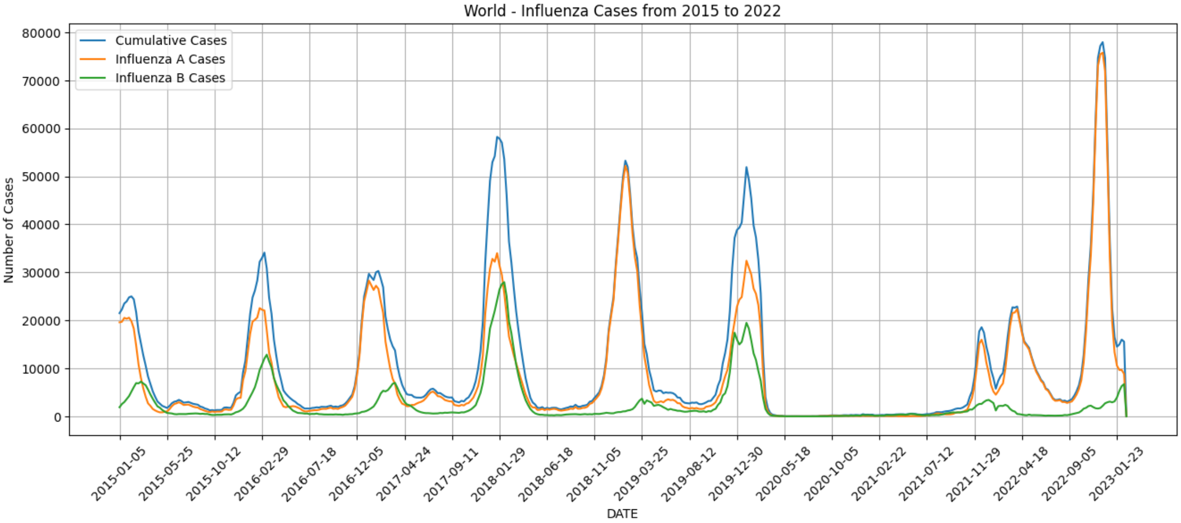
Experiment and Results: Cumulative Influenza Model
Here we illustrate a world cumulative model of influenza cases from 2015-2022.
Significant drop in Influenza observed at the start of 2020, coinciding with the COVID-19 outbreak. Which could indicate stringent public health measures implemented to combat the spread of COVID-19
The end of 2021 we see a resurgence of Influenza cases returning to the most part to pre-pandemic levels, suggesting a return to normal social behavior
Next Step: To further investigate this trend, we delve into more granular data, focusing on specific subset countries.

Slide 15
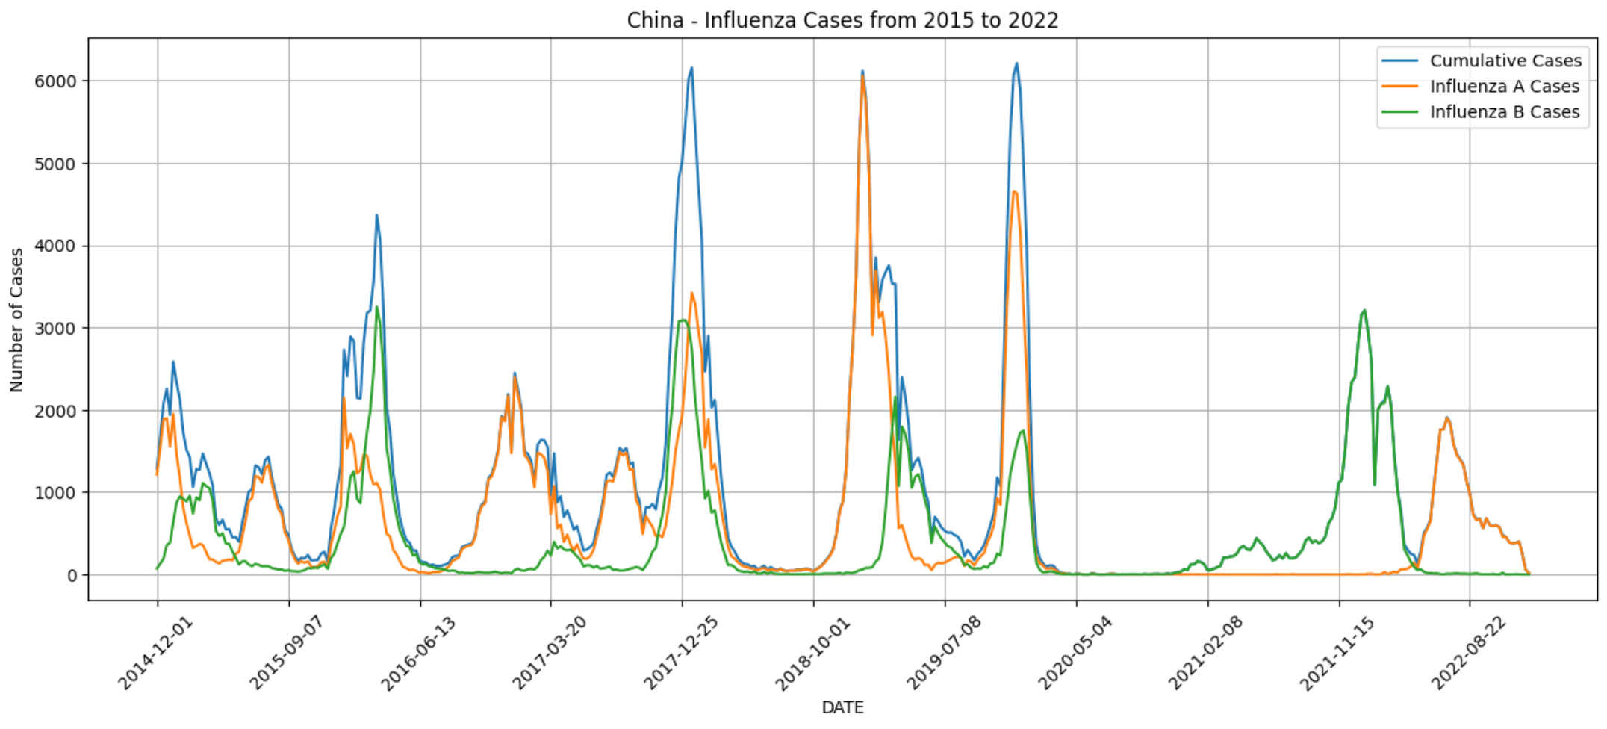
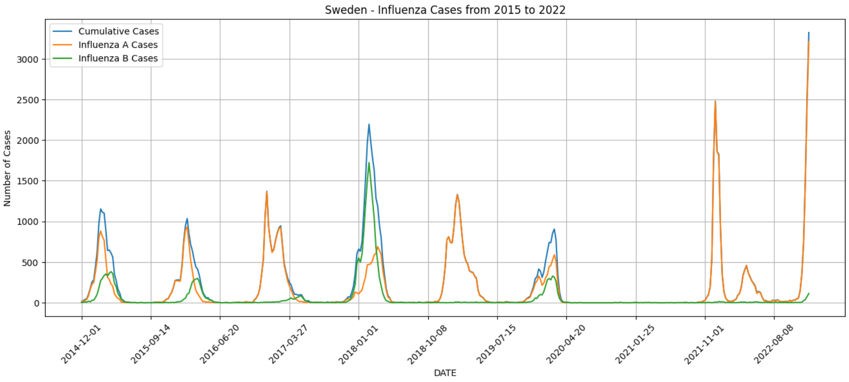
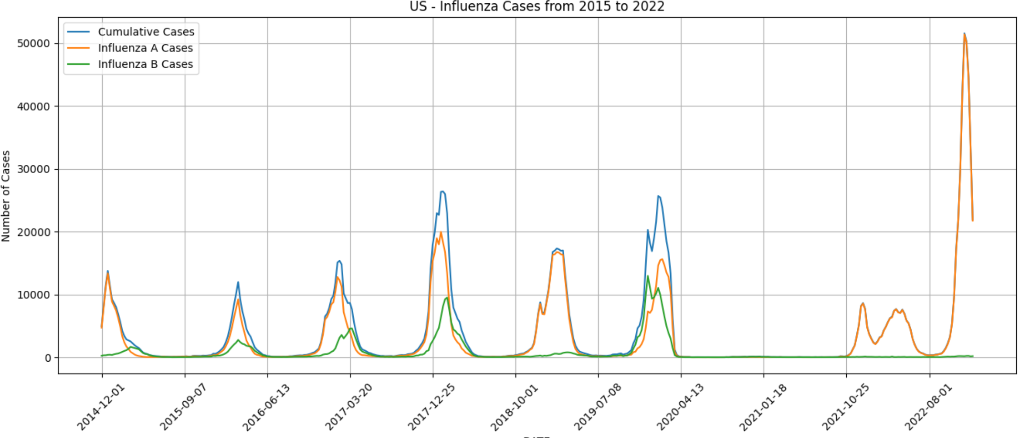
Experiment and Results: Subset Influenza Models
Like the Global model, all subset countries – the United States, China, and Sweden also experienced a sharp decline in influenza starting in early 2020.
Similarly, the decrease in cases corresponds with the onset of the COVID-19 pandemic.
The persistence of this trend until late 2021implies a possible correlation between the implementation of heal measures and changes in social behavior.
These trends support our initial hypothesis that external factors surround COVID-19 have had a significant impact on Influenza cases.

Slide 16
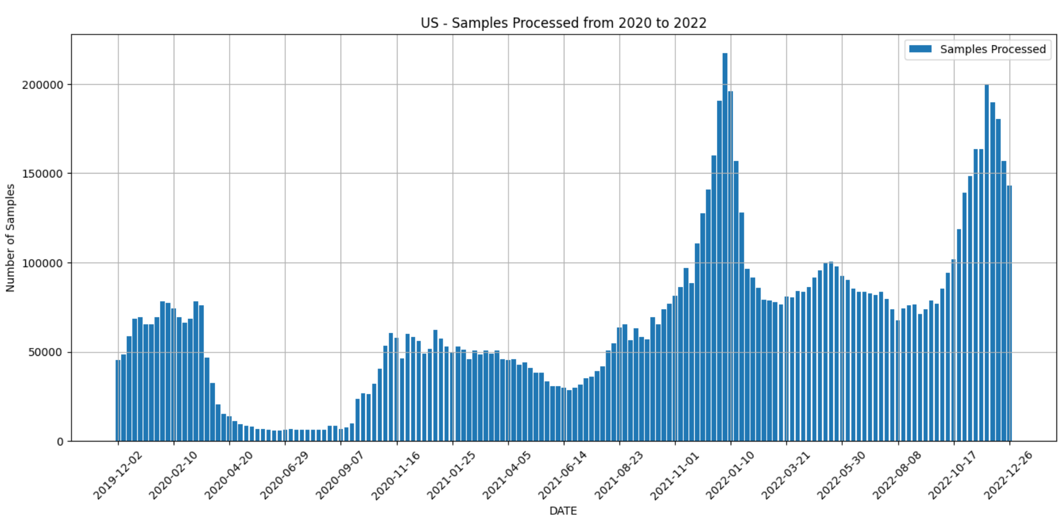
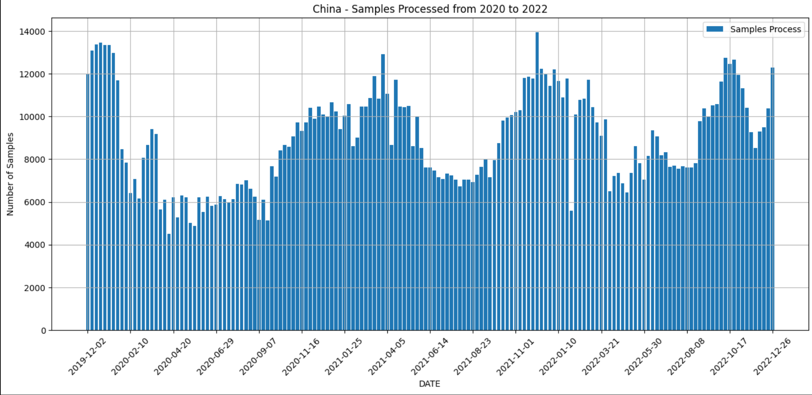
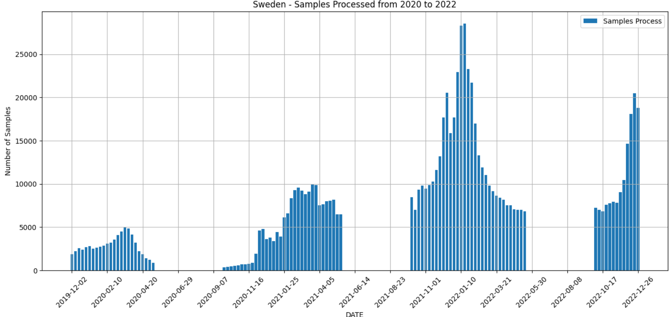
Experiment and Results: Subset Sample Collection
Midway through 2020, there was a decrease in sample processing in all subset countries.
This decline could account for some of the declined cases.
However, by the end of 2020. The number of samples processed returned to normal trends.
Despite this return to regular consistent processing, the decline of Influenza cases persisted for another year.

Slide 17
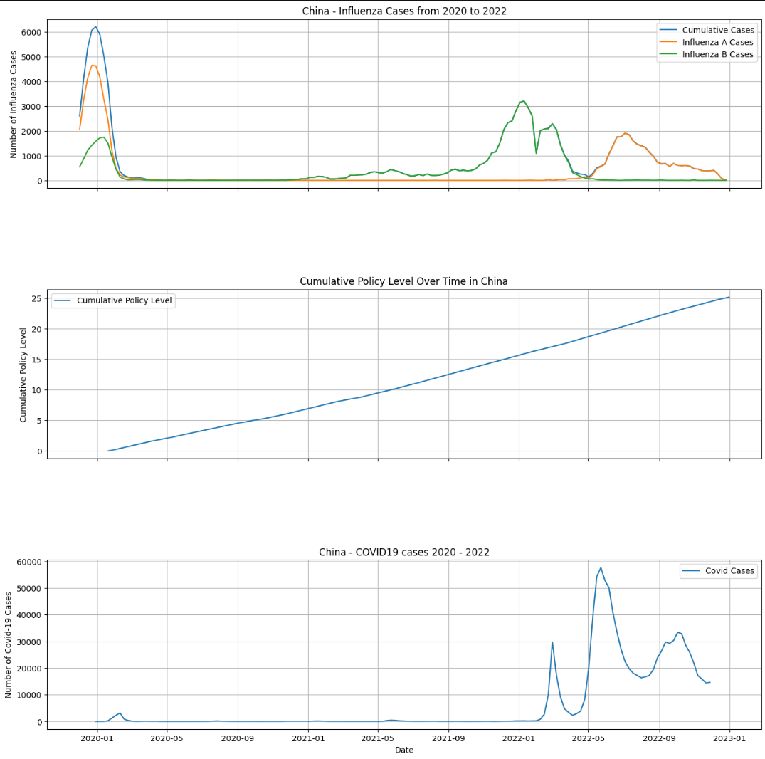
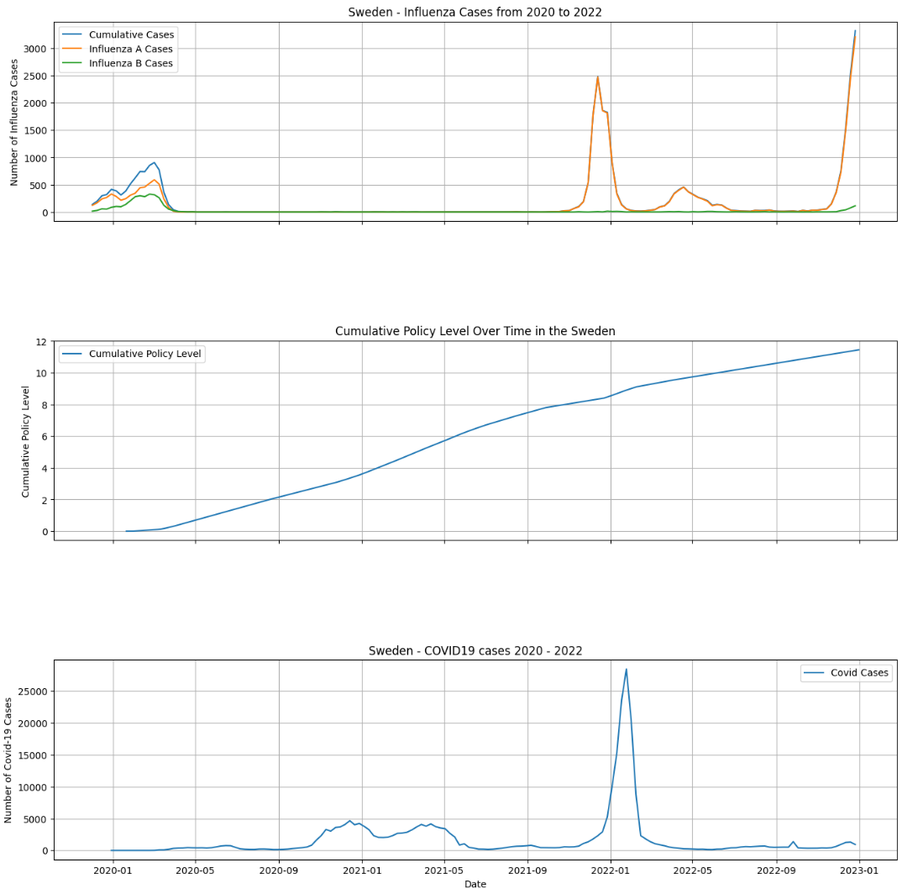
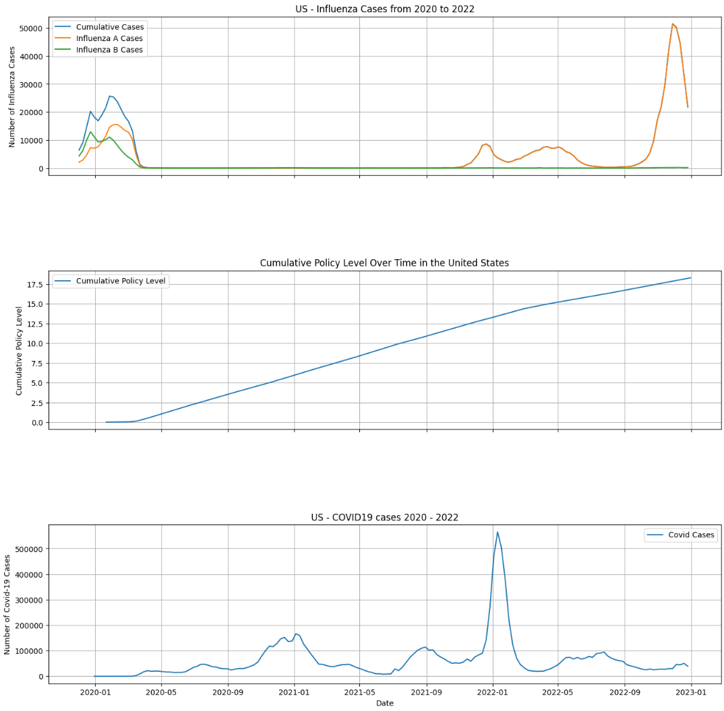
Experiment and Results: Policy, Covid, Influenza Comparision
A strong correlation can be observed between Influenza cases, public health policies enacted, and COVID-19 cases.
As COVID-19 cases increase, more public health measures were implemented to control the spread.
These policy decisions unintentionally mitigated the spread of Influenza.
These trends underline the potential effectiveness of public health measures in controlling the spread of respiratory viruses.

Slide 18
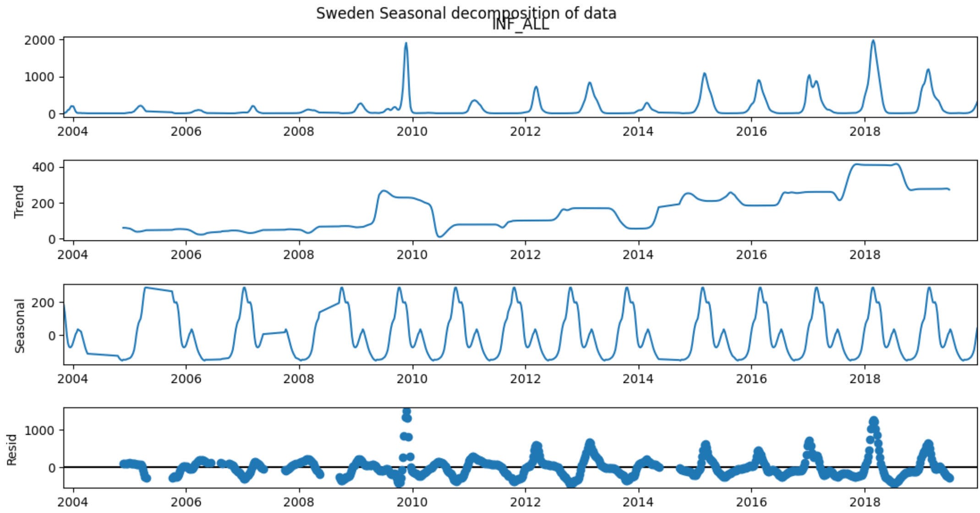
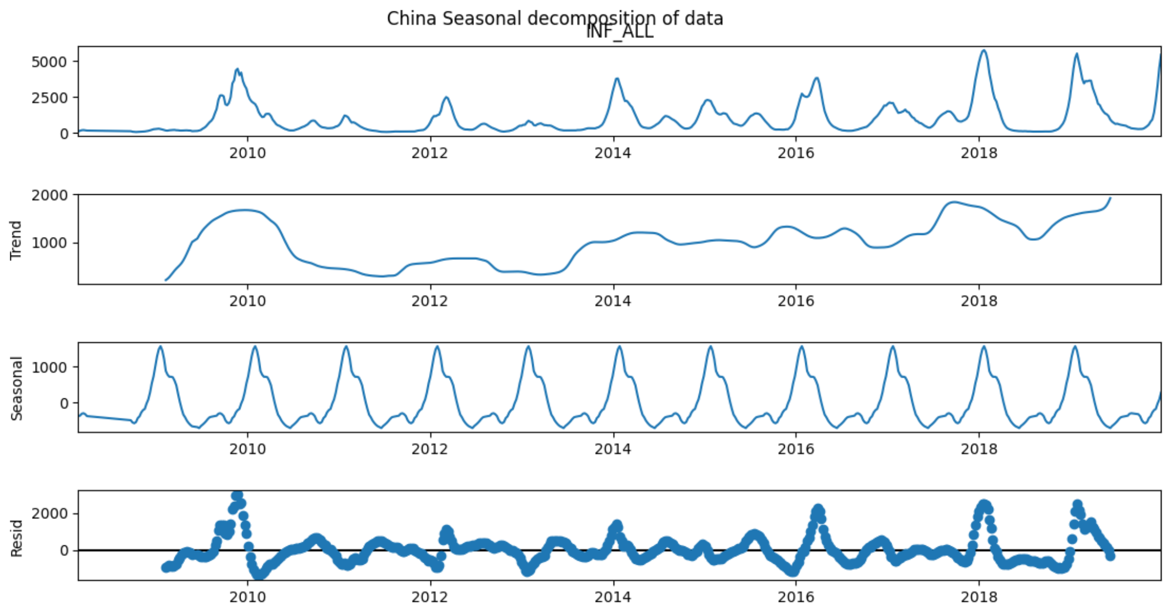
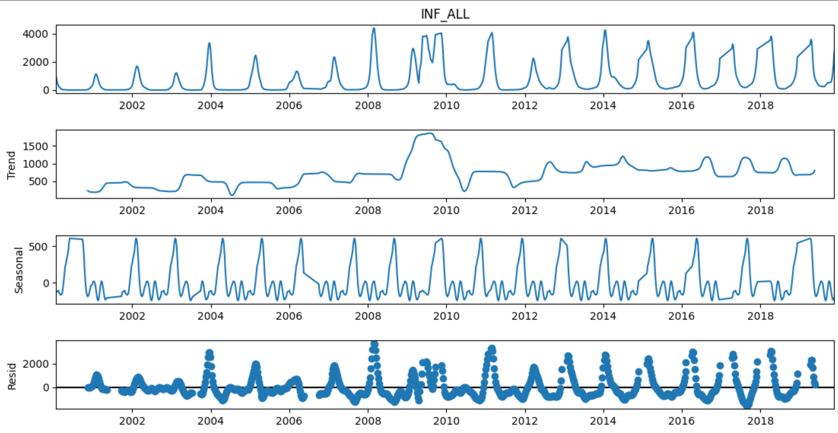
Experiment and Results: Subset Model Decomposition
The first plot of each graph shows the raw original observed influenza cases.
The second plot of each graph shows the trends derived from the original time-series.
The third plot show cyclic seasonal pattern of Influenza cases.
The final plot shows the is noise that is extracted from the data.
This model helps in understanding the trend and seasonality in the data which helps design and tune the LSTM model.
US

Slide 19
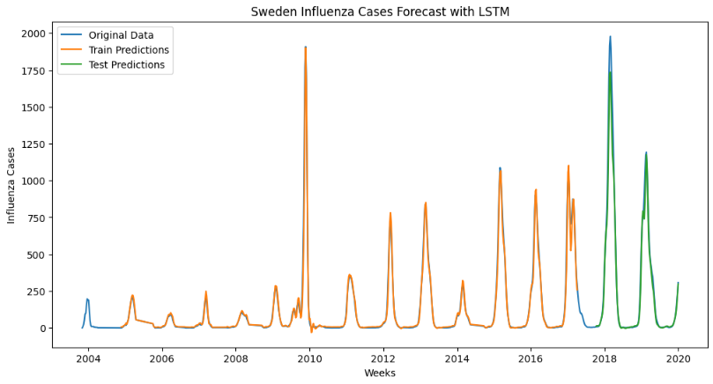
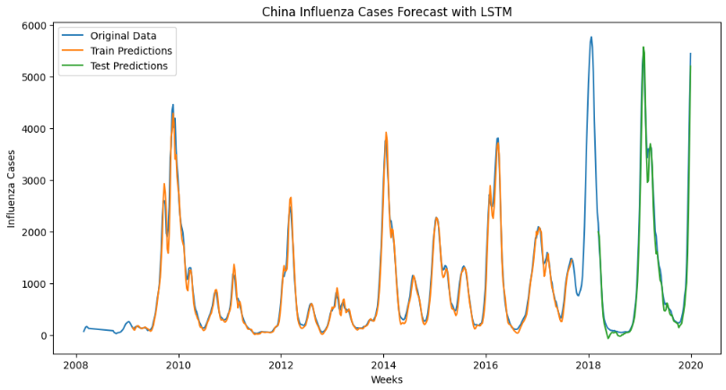
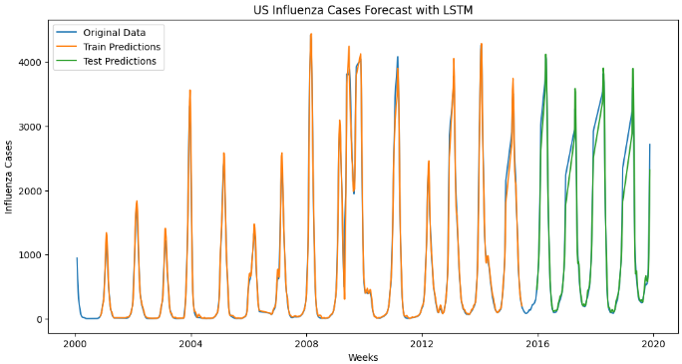
Experiment and Results: LSTM Model Training
LSTM was chosen for its ability to accurately forecast using long-term data.
Data sets are reshaped, normalized between 0 and 1, and split into 80-20 ratio for the training and testing sets for the LSTM.
Look-back period used (dependent on subset country) to use past data in future predictions.
The LSTM learned patterns from the training data and generalized this learning on new data in the testing set.
This suggest capability to accurately forecast influenza cases based on past data.

Slide 20
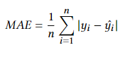
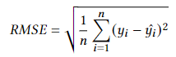
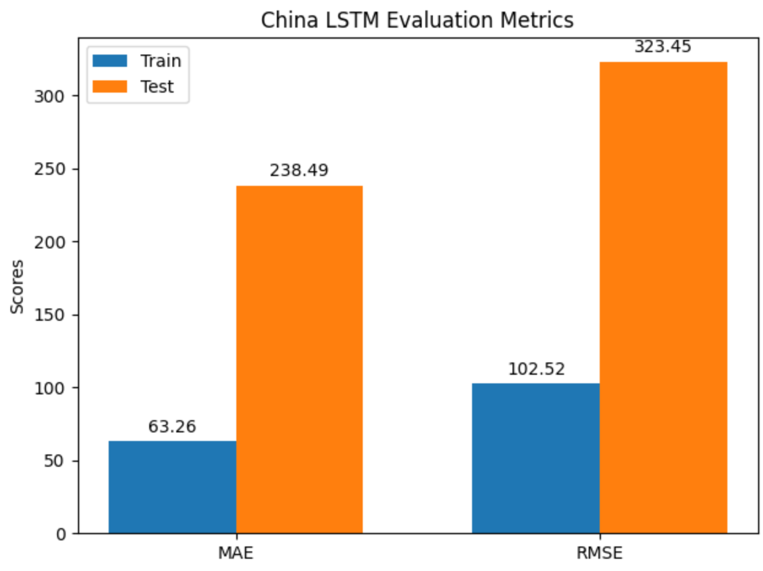
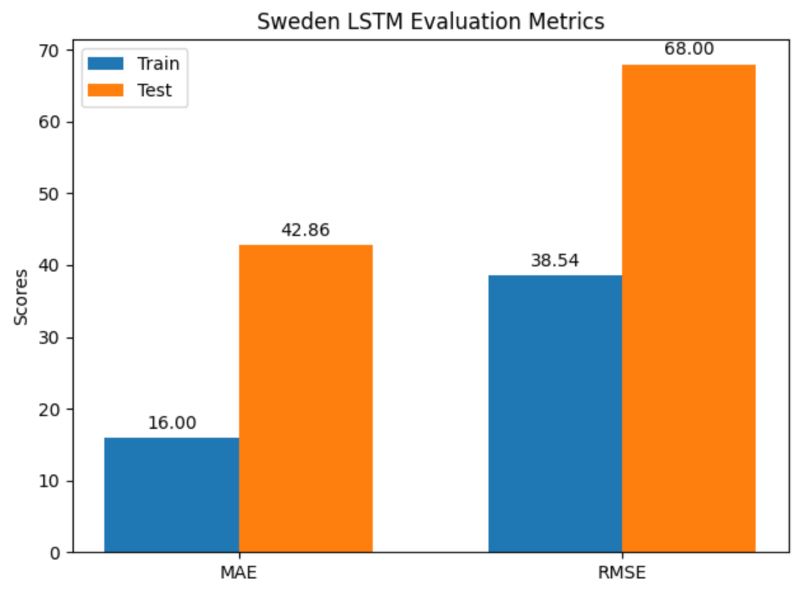
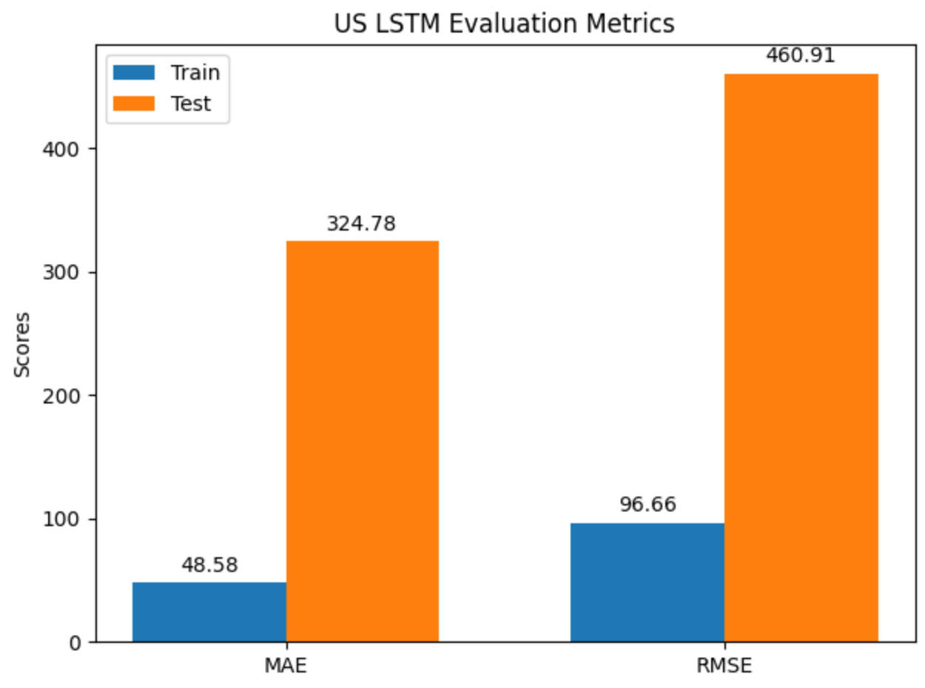
Experiment and Results: LTSM Model Evaluation Metrics
MAE measures the average magnitude of errors in predictions.
RMSE is another measure of prediction error, emphasizing larger errors due to squaring
Notable error differences between training and testing suggest potential overfitting.
Despite some error, the model remains useful for forecasting.
Some regularization and early stopping was considered but impacted forecasting results.

Slide 21
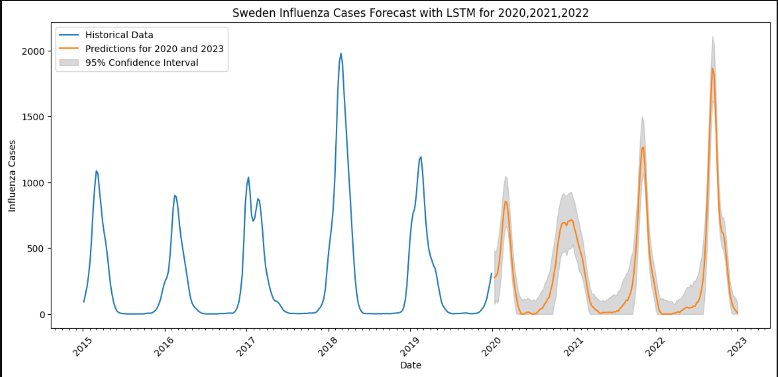
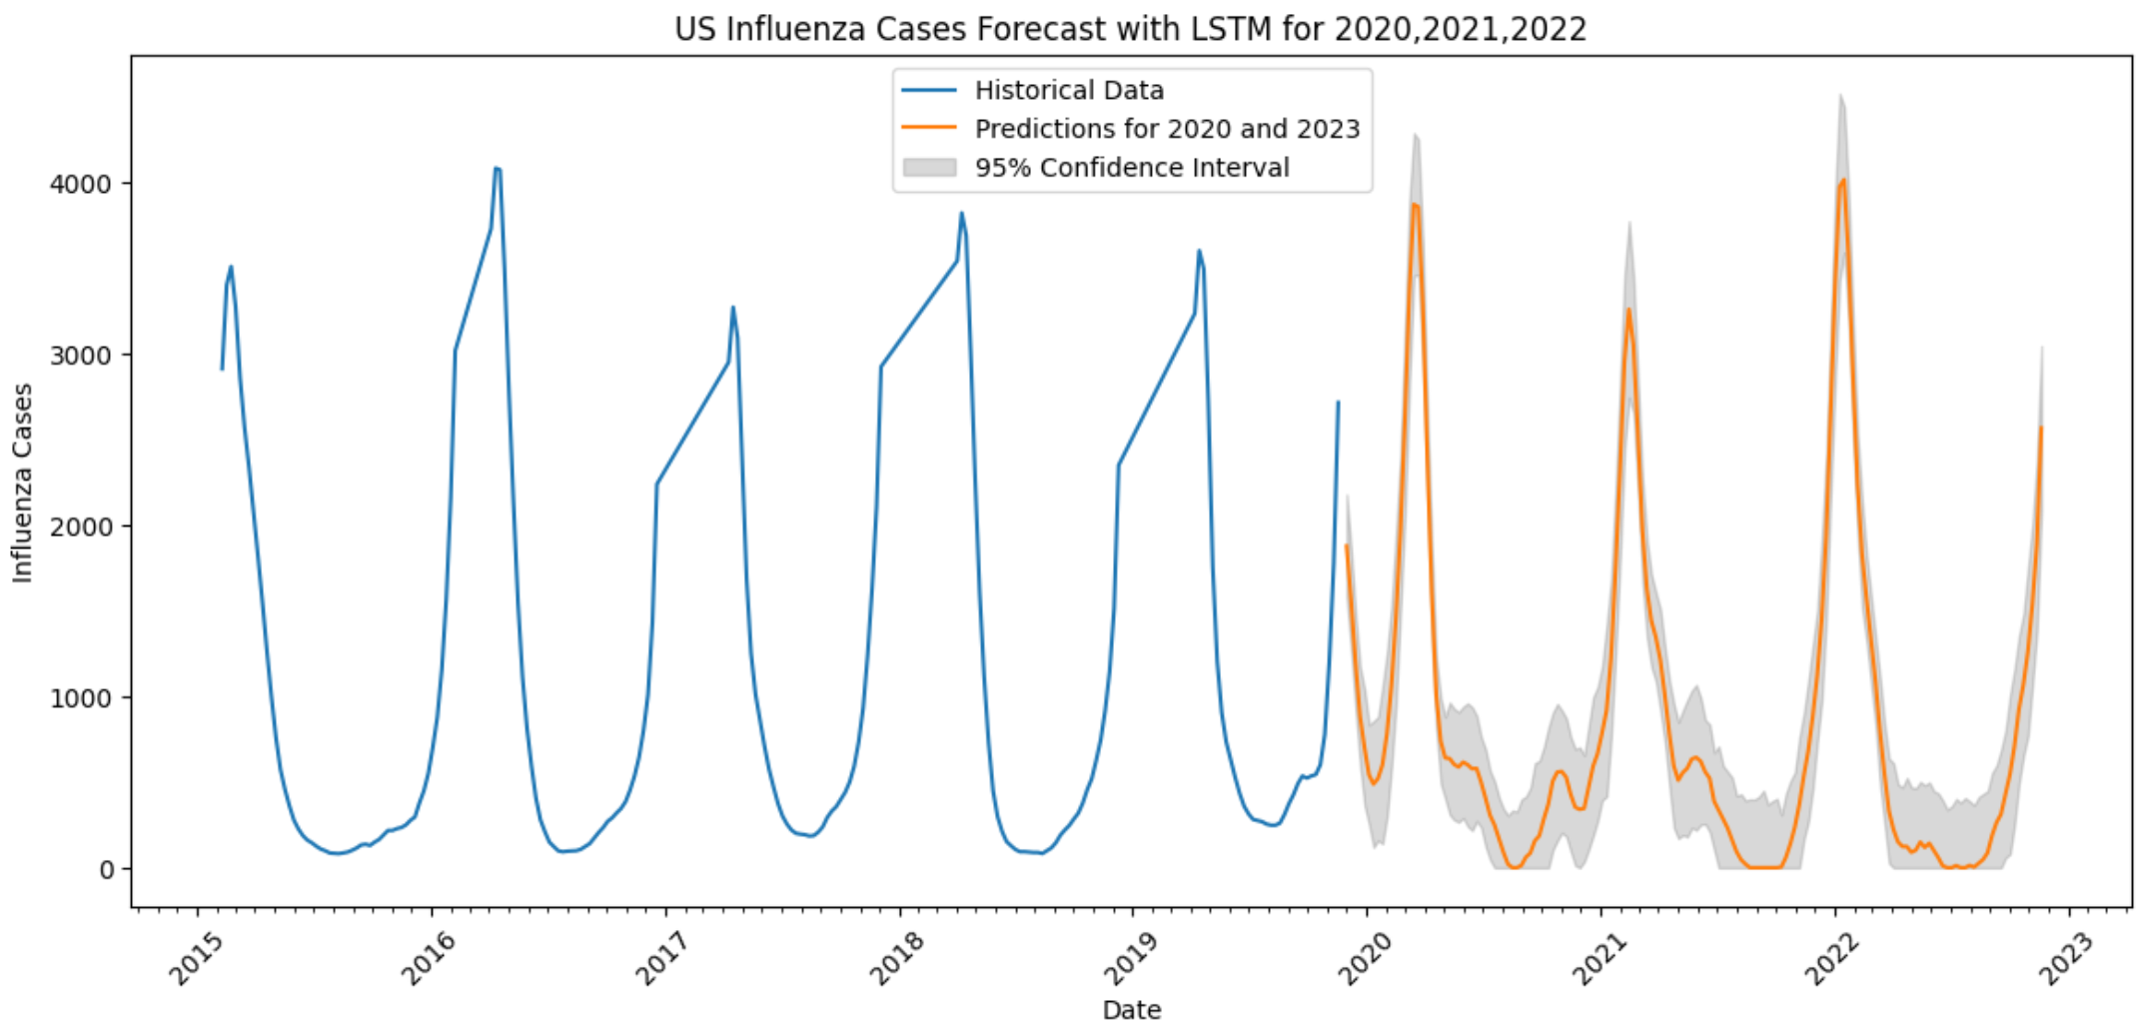
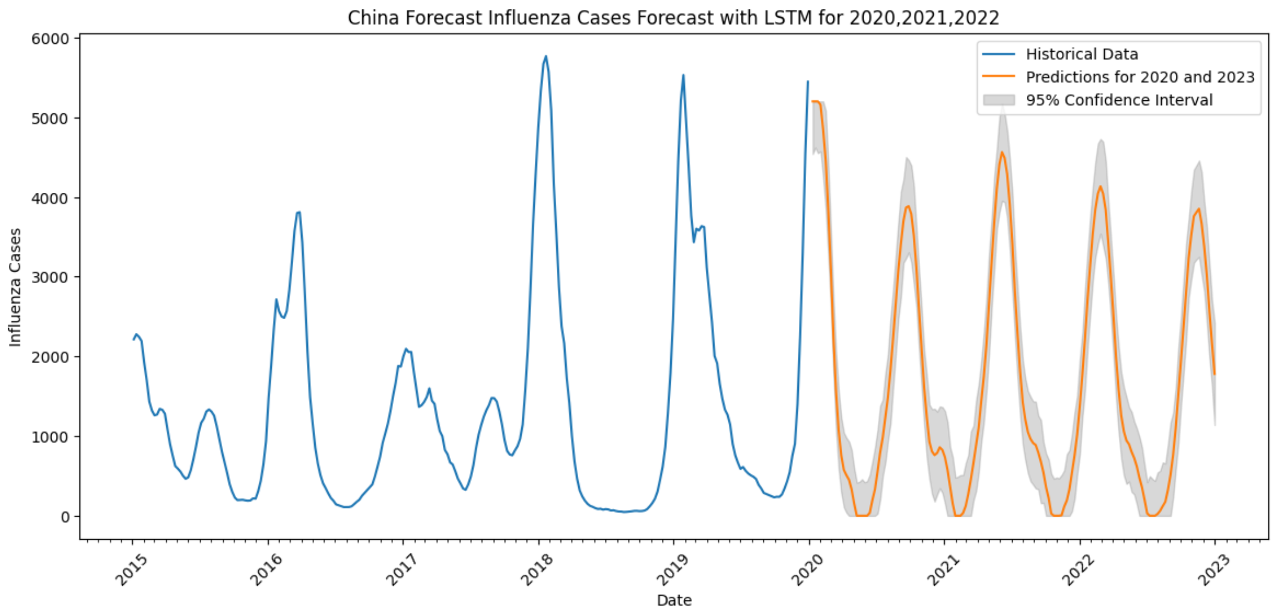
Experiment and Results: Model Forecast
LSTM was used to forecast influenza cases for 2020-2022.
Multiple simulations are run for each of the predictions to estimate the confidence interval around the forecasts.
Forecasts show expected seasonal pattern, with a rise in colder months and decrease in warmer months, which aligns with known Influenza transmission patterns.
Forecasts assume future Influenza trends will follow historic patterns and do not account for potential future variation in strains, vaccination rates, etc.
Results should be considered within the context of these limitations and uncertainties.

Slide 22
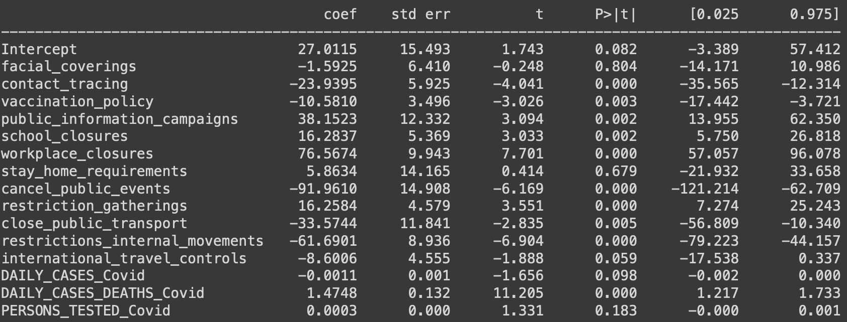
Experiment and Results: Analysis
Ordinary Least Squares:
What are we looking for?
Increase in difference between (forecast – reported) cases
Increase in policy intensity
So, higher coefficient's
Sweden OLS Analysis Results
Notes:
JH

Slide 23
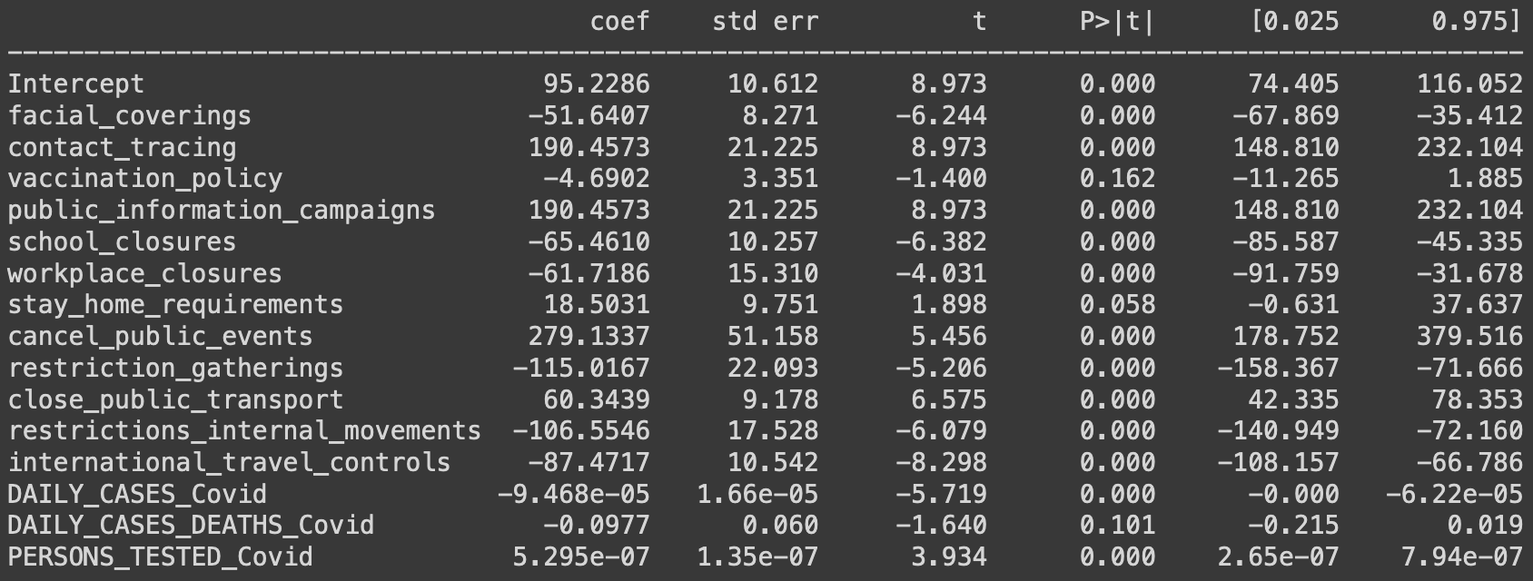
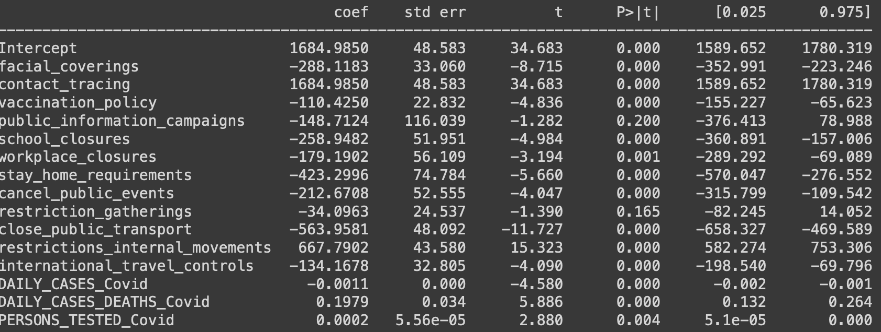
Experiment and Results: Analysis
Trend of public health awareness
No other "one" specific policy
Varied reductions of public interactions
Sweden OLS Analysis Results
China OLS Analysis Results
US OLS Analysis Results
Notes:
JH

Slide 24
Conclusions
Future Directions:
The research uncovers potential correlation between COVID-19 health measures and decrease in Influenza cases.
LSTM model accurately predicts the cyclic nature of Influenza cases, providing an estimate of case numbers during the COVID-19 years.
Study provides insights to inform public health seeking strategies and highlights the complex interplay of factors influencing disease transmission.
Refinement to the LSTM model to account for additional variables like vaccination rates, population density, and specific health policies.
Extend the model to study COVID-19's impact on other infectious diseases for a broader understanding.
Investigate the impact and effectiveness of public information campaigns.
Consider costs associated with each policy for a move to a Weighted WLS model.

